Slide 1
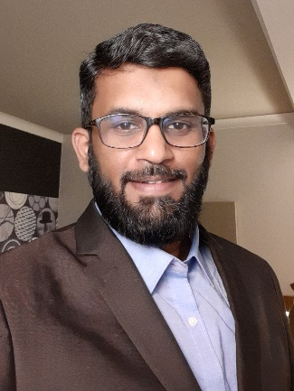

Cloud & Data Center Lead
Abdul Hye
Overall Experience:
Principal Architect with 19+ years of experience in Cloud Architecture, Security, Migration, and Digital Transformation, delivering large-scale cloud and infrastructure modernization programs.
Design and deliver cloud architectures aligned with Well-Architected Framework principles.
Lead complex cloud deployments, migration programs, and transformation initiatives.
Architect and integrate enterprise-scale security tools and services.
Deliver large-scale application migration, modernization, and deployment projects.
Extensive experience in Azure tenant-to-tenant and subscription-level migrations.
Design and implement greenfield SAP on Azure environments.
Establish Azure security and compliance frameworks aligned with CCoE standards and multi-cloud governance.
Specialized in architecture, design, planning, implementation, and migration of large-scale cloud and security projects.
Hands-on technical leader with strong stakeholder engagement and communication skills.
Design Azure Landing Zones and automate network and VM deployments using Terraform, Ansible, and Octopus Deploy.
Strong expertise in cloud migration lifecycle management and transitioning on-premises workloads to Azure using R-Lane migration strategies.
Provide architectural leadership, assessments, PoCs, governance, and technical mentorship as part of Enterprise Architecture and CCoE initiatives.
Experienced in cloud assessments, optimization, governance, and operational best-practice recommendations.
Experience – 19+ Years
Qualification – Bachelor of Engineering
Certifications – AZ-305, AZ-120 and ITIL v3 Foundation Certified, Cloud FinOps professional, TOGAF 10 EA, G42 trained
Primary Skills
Cloud Architecture & Migration (Azure, AWS, GCP, SAP on Azure, Landing Zones)
Cloud Security & Governance (CCoE, Security Frameworks, Compliance, Enterprise Architecture)
Cloud Transformation & Infrastructure Modernization (Design, Build, Migration, Optimization)
Secondary Skills
DevOps & Infrastructure as Code (Terraform, Azure DevOps, ARM Templates, PowerShell)
Cloud Platforms & Virtualization (Azure, AWS, GCP, VMware, Hyper-V)
FinOps, Backup & Disaster Recovery (Cloud Cost Optimization, BCDR, Migration Lifecycle Management)
1
© Confidential – www.happiestminds.com

